Slide 1
Supercharging Github Copilot
Building custom VS Code extensions

Slide 2

Intro
Joeri Lieuw
Devops Engineer
Tribe Credit Core
XPRTZ Consultant

Slide 3
Agenda
Custom instructions:
Code generation / test generation / prompt files
AI Concepts
Prompt Engineering
Embeddings
Tool calling
MCP Server

Slide 4
Prompt Engineering
Adding additional context

Slide 5
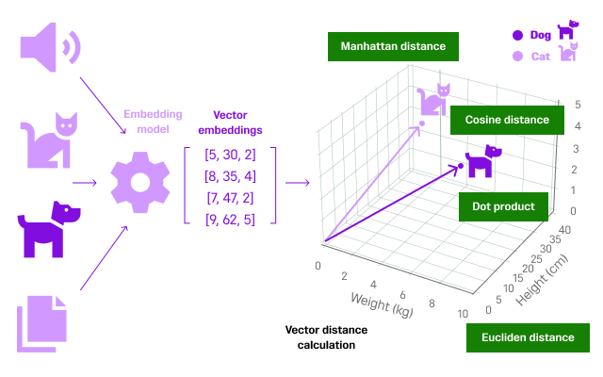
Vector Stores
Embeddings

Slide 6
Vector Stores
Adding additional context

Slide 7
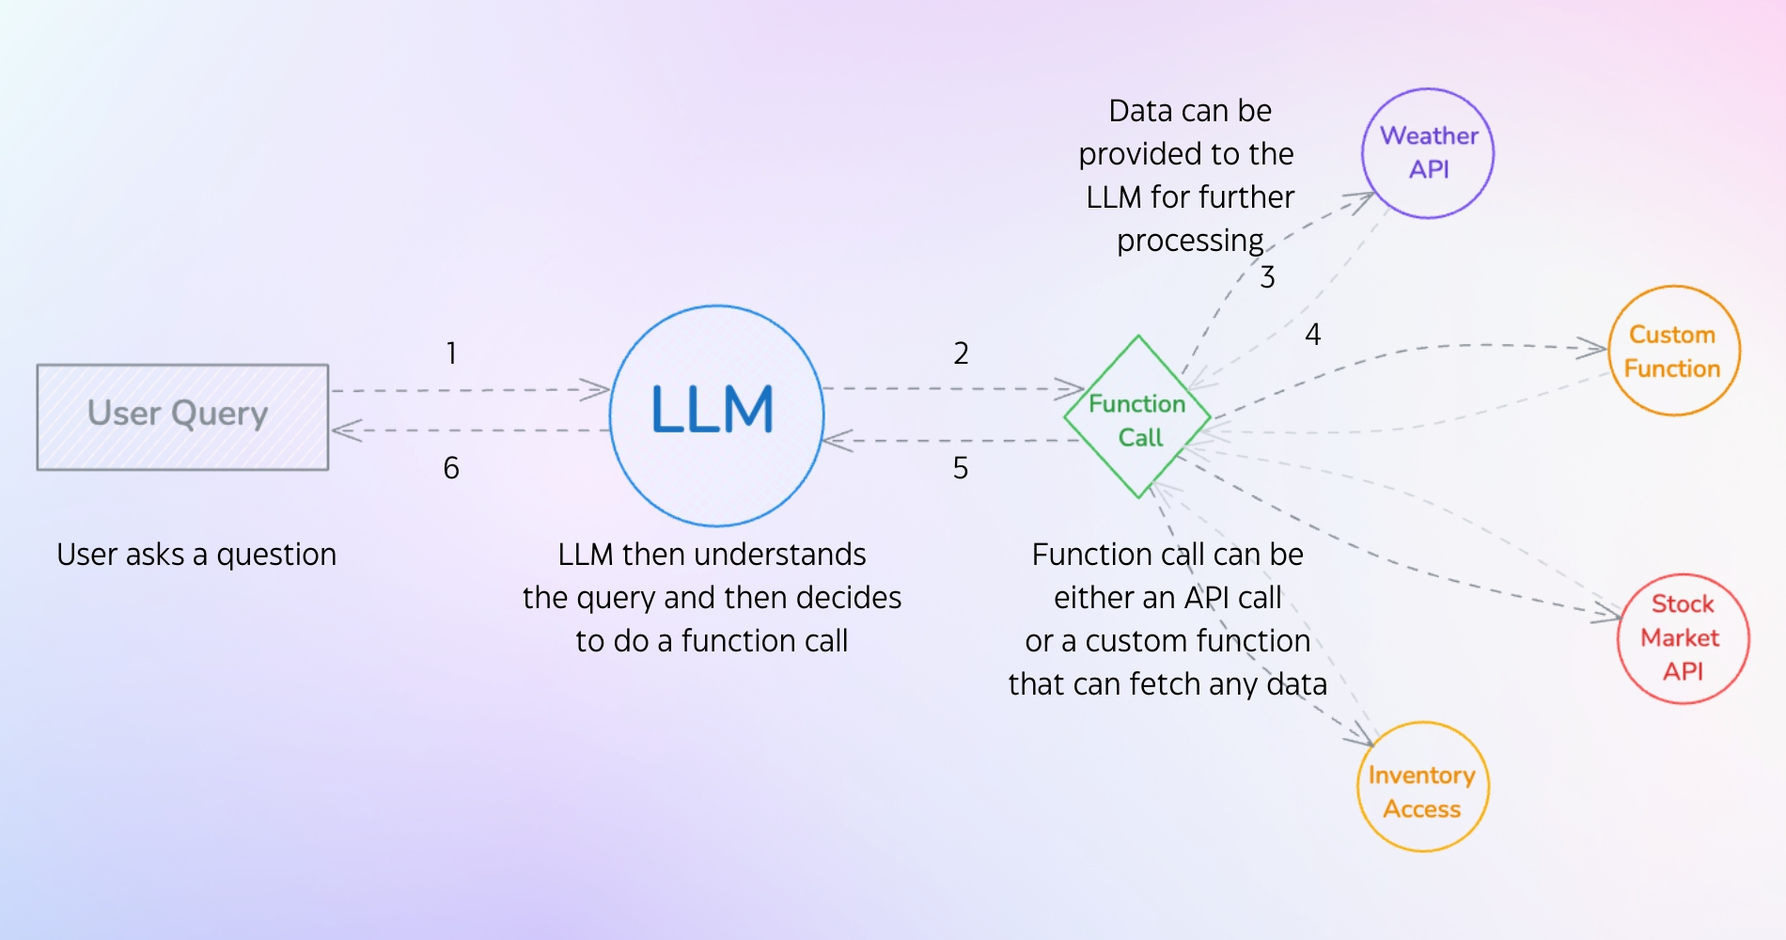
LLM Tool Calling

Slide 8
Custom instructions
Adding additional context

Slide 9
VS Code Extensions
Adding chat handler

Slide 10
Retrieval Augmented Generation
API Call

Slide 11
Retrieval Augmented Generation
Vector search

Slide 12
VS Code Extensions
Adding tools

Slide 13
VS Code Extensions
Adding Model Context Protocol

Slide 14
VS Code Extensions
Adding Model Context Protocol

Slide 15
Custom instructions
Adding additional context

Slide 16
Custom instructions
Adding additional context

Slide 17
Custom instructions
Adding additional context

Slide 20
Speaker tips
Tips:
Craft a clear story that is tailored to your audience. What’s the essence of your story? What do you want your audience to do, feel or remember? How to you end the presentation, a short summary (max 3. items to remember), a quote or a call-to-action?
Think beforehand about how to engage your audience. Online presentations require more effort to keep your audience engaged. Regularly interact with them by asking questions and encouraging participation.
Make sure to use clear visuals and high-contrast colours in presentations. This makes your content accessible and easy to understand, also for those with visual impairments.
Do you…
Need tips on how to give a powerful presentation? Use Mark Robinson’s presentation format. Find the explanation in this short (18 min.) Ted Talk .
Want to practice your presentation skills and improve your speaking skills? Organize a Speakers Academy session or join the workshop (March 5).
Need support on standard communication materials (such as templates, images, visuals etc.)? Go to The Brand Portal.
Want to make your presentation interactive? Use breakout rooms or RaboVote. Find an explanation here.
For all other speaker information, please go to the speakers page.

Slide 23

Thank you for your attention!
Questions?

Slide 24
Speaker tips
Tips:
Craft a clear story that is tailored to your audience. What’s the essence of your story? What do you want your audience to do, feel or remember? How to you end the presentation, a short summary (max 3. items to remember), a quote or a call-to-action?
Think beforehand about how to engage your audience. Online presentations require more effort to keep your audience engaged. Regularly interact with them by asking questions and encouraging participation.
Make sure to use clear visuals and high-contrast colours in presentations. This makes your content accessible and easy to understand, also for those with visual impairments.
Do you…
Need tips on how to give a powerful presentation? Use Mark Robinson’s presentation format. Find the explanation in this short (18 min.) Ted Talk .
Want to practice your presentation skills and improve your speaking skills? Organize a Speakers Academy session or join the workshop (March 5).
Need support on standard communication materials (such as templates, images, visuals etc.)? Go to The Brand Portal.
Want to make your presentation interactive? Use breakout rooms or RaboVote. Find an explanation here.
For all other speaker information, please go to the speakers page.

Slide 25

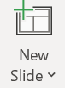

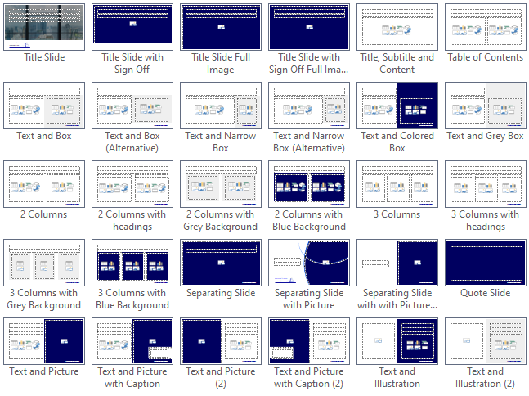
How to use this deck
Edit the slides in whatever way you like. You can stick to the standard or personalize your presentation. Engineer’s Week is all about your knowledge, input & creativity, so feel free to customize the slides to fit your story.
Be aware no to include any sensitive information!
Add a new slide by clicking the ‘new slide’ button in the home menu. Here, you can choose one of the many template slides available.
Add icons, illustrations, photography etc. with the templafy plug-in or download them from the Brand Portal.
This plug-in is installed by default. Is the button not visible? Go to file → options → add-ins → click Templafy PowerPoint Add-in → go → select Templafy box → ok.

